Slide 1


Slide 2
Exploring DPF Failure Across 3 Vehicles
Sam Ahmadi

Slide 3
Objective
Analyze the dataset for 3 vehicles all affected by the same DPF problem — to identify which variables correlate with, precede, or drive the onset of the issue.
Examine each vehicle's behavior around its known onset date
V1: 12-09-25 · V2: 13-09-25 · V3: 14-09-25
Look for patterns that are consistent across all three vehicles
Form early hypotheses about what the data suggests — not a production model

Slide 4
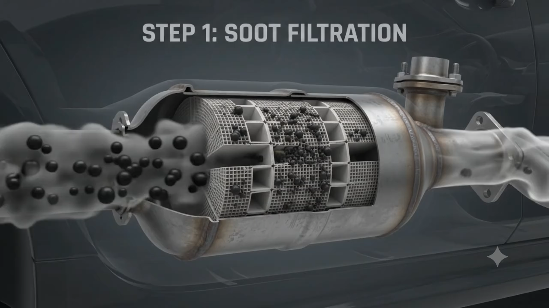
Diesel Particulate Filter (DPF)
A filter in the exhaust system that traps diesel soot to cut emissions.
Regeneration: periodically burns off trapped soot to clear itself
The problem: when regeneration fails, soot builds up and block the filter.

